Slide 1
Game Design: Powerball lotto
How we can get the highest possibility to win by spending least amount of money?

Slide 2
Introduction
Powerball is a lotto game that pick balls each week.
The rule is listed as follow:
Players pick 5 white balls in 69 candidates
Pick 1 red balls(also known as “powerball”) in 29 candidates
A random power rate will be chosen each weak, will multiply the reward players get by this rate. For example, if the rate is 4 this week and player win 10 dollars, the player will eventually get 40 bucks
Details are shown by the following pictures from powerball official website

Slide 3
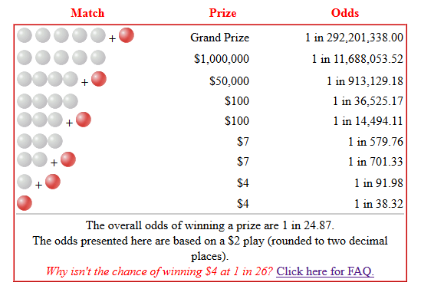
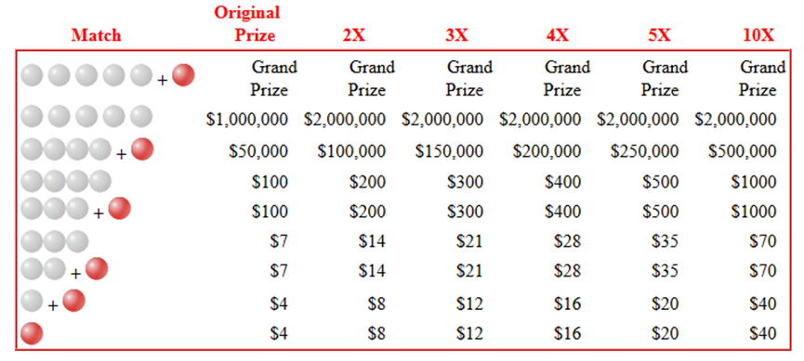
Introduction

Slide 4
Our strategies
According to probabilities, each white ball and red ball have independent possibilities. The white ball is 1/69 and the red ball is 1/26.
However, according to the history statistics, the possibilities for each balls is totally different.
For example, the white ball #32 has the highest possibilities among all the history winning data, about 2.05%. The lowest white ball #65， however, has only 0.09% possibility. That’s about 23 times difference.
The highest red ball is #20, about 4% and #4 has the lowest possibility of 2%.

Slide 5
Our strategies
I searched online and found lots of strategies for picking the number. For simplicity in designing this game, I pick some most important strategies as policies for our game.
1:
This means that it make sense to pick balls that has the highest possibilities among all the candidates. As a result, I need to find out all the possibilities for all the white balls and red balls.

Slide 6
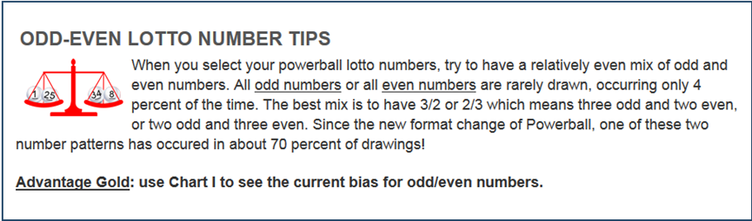
Our strategies - odd/even
Odd/Even | Possibilities
0/5 | 0.014
1/4 | 0.204
2/3 | 0.286
3/2 | 0.286
4/1 | 0.197
5/0 | 0.014

Slide 7
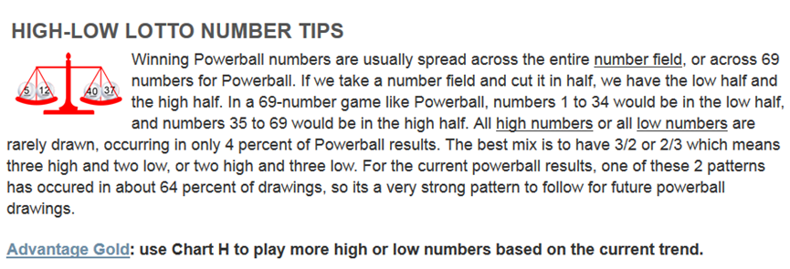
Our strategies - high/low
low/high | possibilities
0/5 | 0.027
1/4 | 0.15
2/3 | 0.313
3/2 | 0.299
4/1 | 0.156
5/0 | 0.054

Slide 8
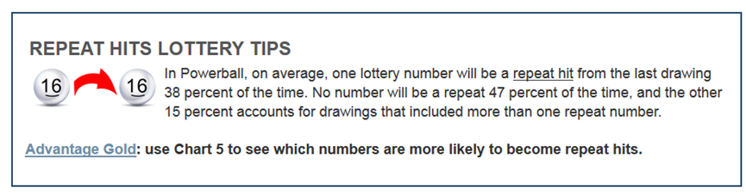
Our strategies - repeat
There are 38% possibility that one repeat hit from last drawing,
no repeat 47%, and 15% that has more then one repeat number.
As a result, we need to compare the result with the most recent
result(as stated above, from the last drawing) to check the repeat possibility

Slide 9
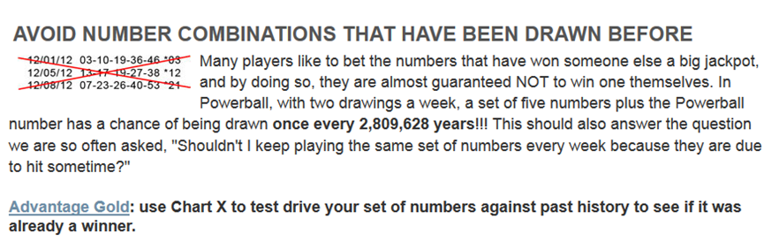
Our strategies – don’t copy and paste
It seems that the powerball has the same rule as a software engineer

Slide 10

Math model
I built a pretty straight forward math model for this problem, since we need to consider the low-high, odd-even and the repeat in the total possibilities for each combination. According to possibility theory, we need to get the product of all these possibilities(not add them up since they are all independent)
Here:
P(wi) represents i-th white ball possibilities, for each combination, we get the product of all the white balls.
P(R) represents possibilities of red ball(powerball)
P(OE) represents for possibilities of odd-even(for given odd and even number of that combination)
P(LH) represents for possibilities of low-high(for given low and high number of that combination)
P(repeat) represents for the repeat possibilities

Slide 11
Our algorithm
As stated above, I need to read a file that store all the history winning records(it can be found http://www.powerball.com/powerball/pb_nbr_history.asp), find out all the possibilities for each white and red balls, and its power rate.
Then I pick the top 10 white balls and top 5 red balls and compute the possibilities. The simple math model is shown in previous slide. Using this formula to compute possibilities for each combination. Get rid of the results that does not follow this formula and store the formula in a vector.
Sort the possibilities in descending order
Find the top k results
sort() (O(nlogn))
Bubble sort (O(n*n))

Slide 12
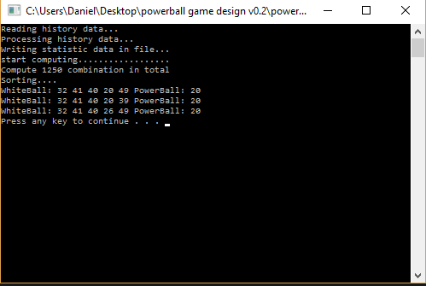
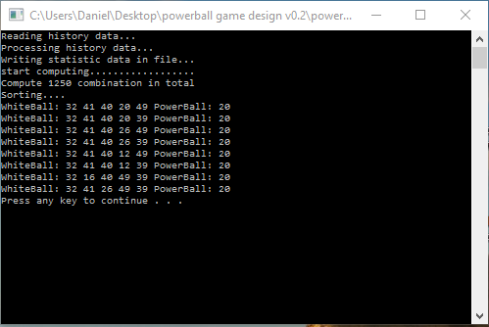
Results demo:
Generating top 5 results
Generating top 8 results

Slide 13
Conclusion
A readme file will be included in the folder, which will tell some more details about the data I used, source I used and how to play this game on a Linux. I implemented the program in windows visual studio. It should be easier for a Linux user to run and compile this.
Thank you for giving me a chance to modify my program. I hope this is the style you prefer. For the previous version, I focused too much on the algorithm and how to solve the problem. I should consider more on how to make it easier for my co-worker to check and modify my code.

